Slide 1
DATA ANALYST TASK

Slide 2


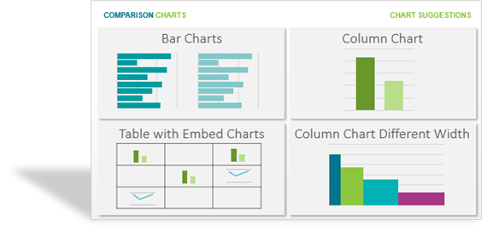


DATA FLOW DIAGRAM
Data Sources
BI Tool
Report

